Slide 1
2020.7.9
Ziyu Tao

Slide 2
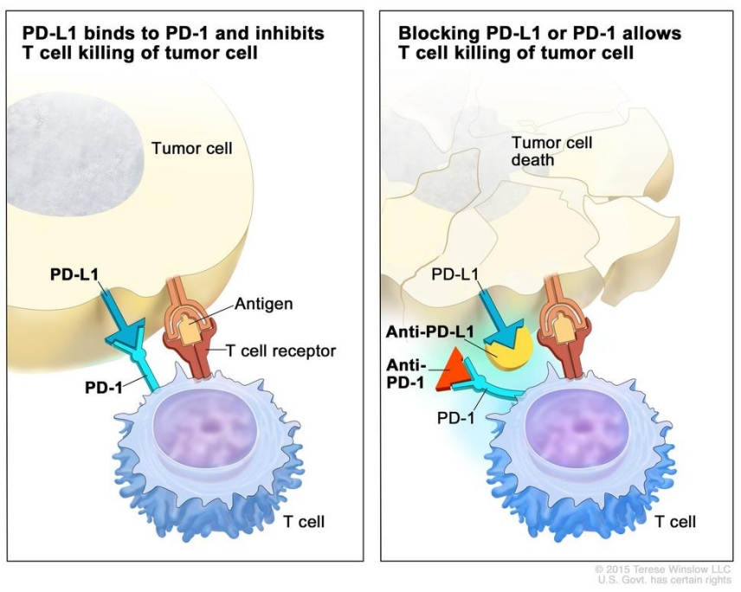
Background
Immune checkpoint inhibitor（ICI）
These immunotherapy drugs blocking checkpoint proteins from binding with their partner proteins such as PD-(L)1, CTLA-4.
Only few patients profit from
immune checkpoint inhibitor.
Z Zhang et al., Nature 2020

Slide 3
Aims
New combine signature biomarker predict immunotherapy
Construct model between biomarker and immune landscape

Slide 4
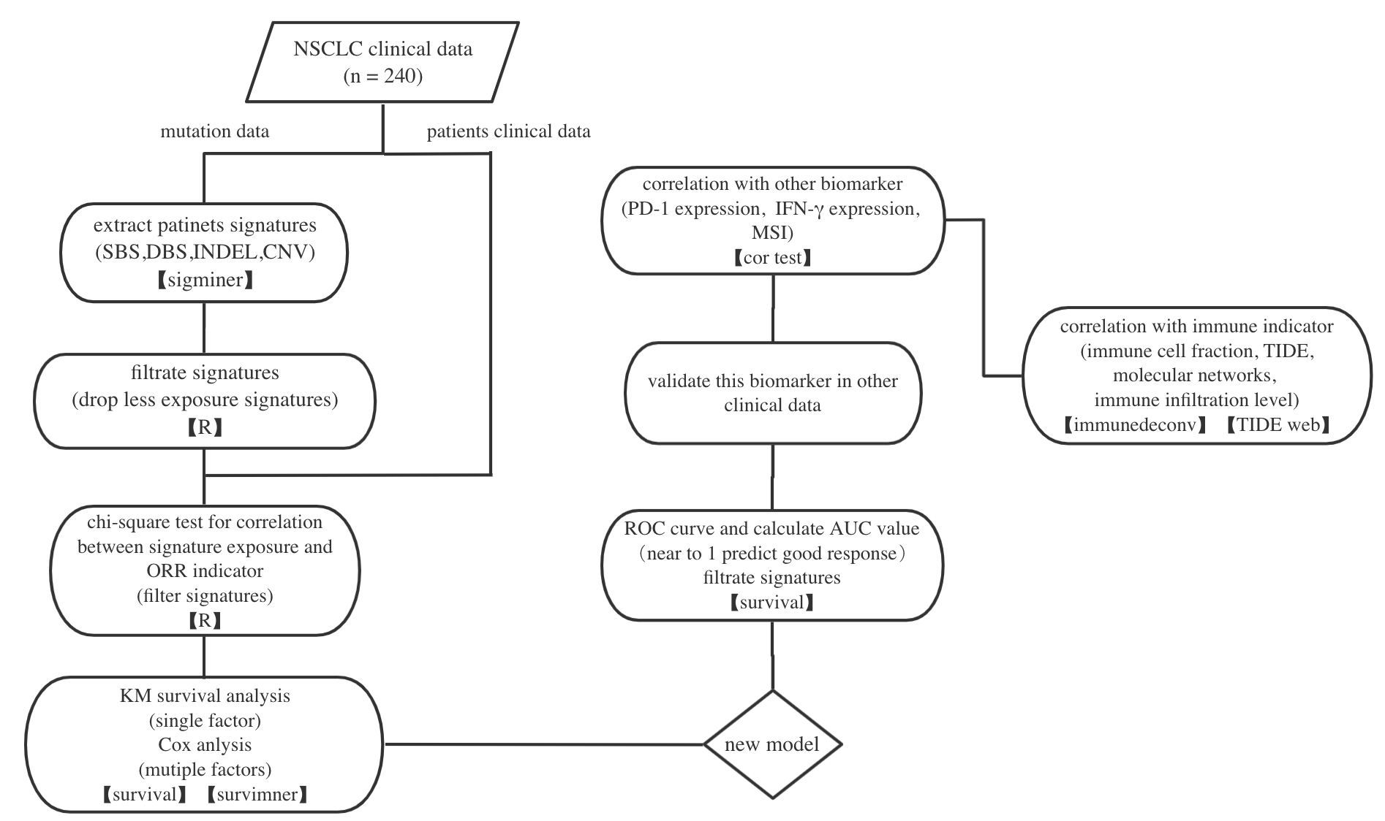
Process design——modeling and validation

Slide 5
Further details
Signature stability
Use different methods to extract signature and check whether this model can consistently predict response.
Possible results:
Different signatures model.
Compare tools and choose one tools.
2. Consistently signature model.
Good.

Slide 6
Further details
Population stability
Use different source of patients data extract signatures to validate.
Factors:
Gender, age, detail of cancer type, treatment type(combination or monotherapy), smoke.
Possible results:
Some population response differently.

Slide 7
Question
If two biomarker predict good response groups are less overlap, how to deal with it.

